Slide 1
Week 3: Mathematical Tools for Image Processing
Fatoş T. Yarman Vural
Hazal Moğultay

Slide 2
There is nothing more practical than a good theory! Vladimir Vapnik

Slide 3

Image Representation

Slide 4
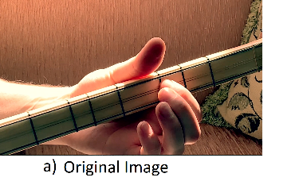
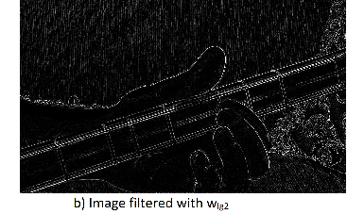

Slide 5
Image Representation
Functions,
Arrays,
Matrices
Vectors

Slide 6

Image Representation by 2-D Functions
$$f:D→R$$
Domain, $d∈D, \text{d}\text{= (}\text{x}\text{,}\text{y}\text{), } pixel coordinates$
Range $r∈R$, brightness values

Slide 7
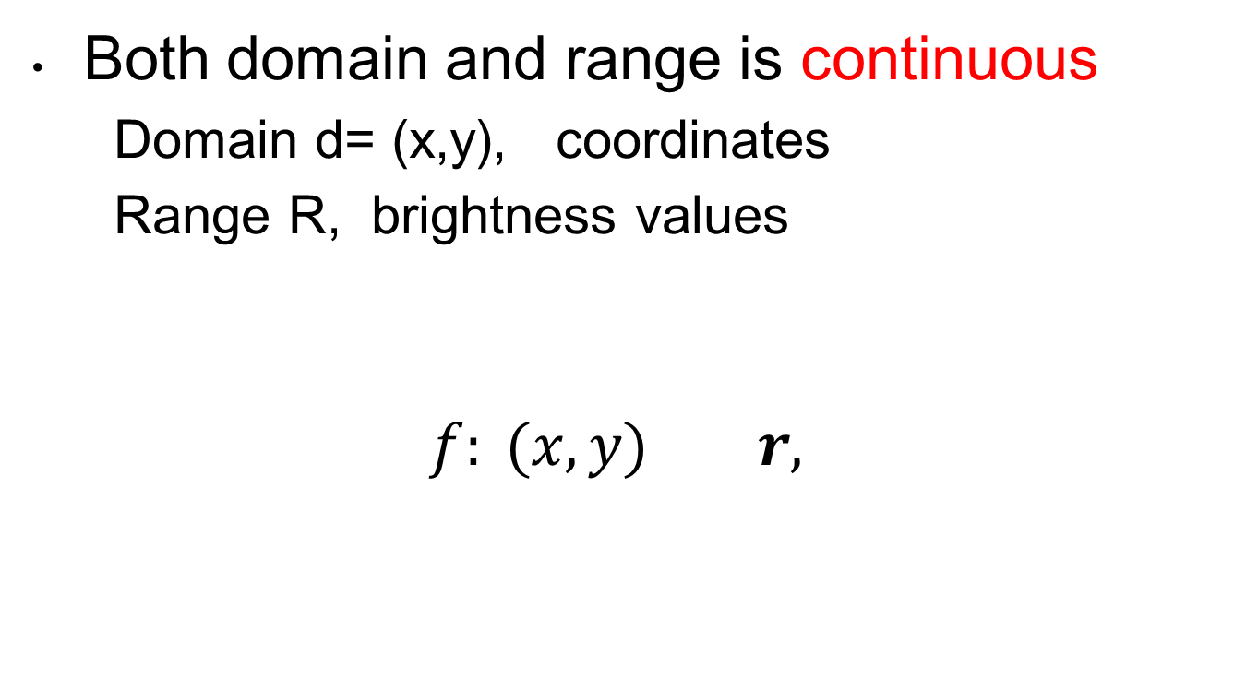
Continuous Images
Both domain and range is continuous
Domain d= (x,y), coordinates
Range R, brightness values
$f: (x,y) r,$

Slide 8
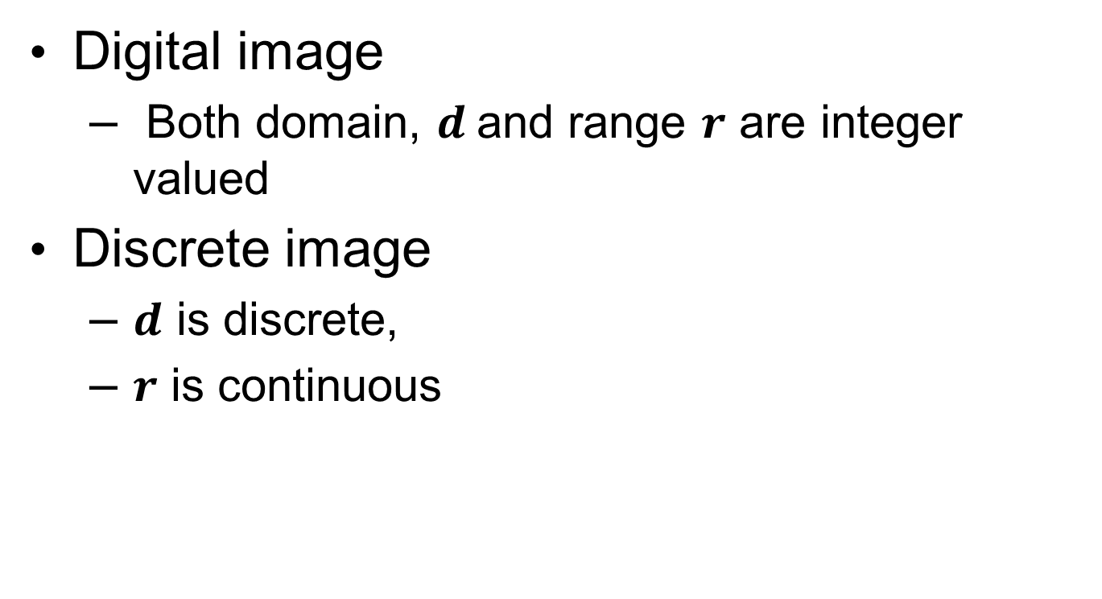
Digital vs. Discrete Images
Digital image
Both domain, $d$and range $r$ are integer valued
Discrete image
$d$ is discrete,
$r$ is continuous

Slide 9
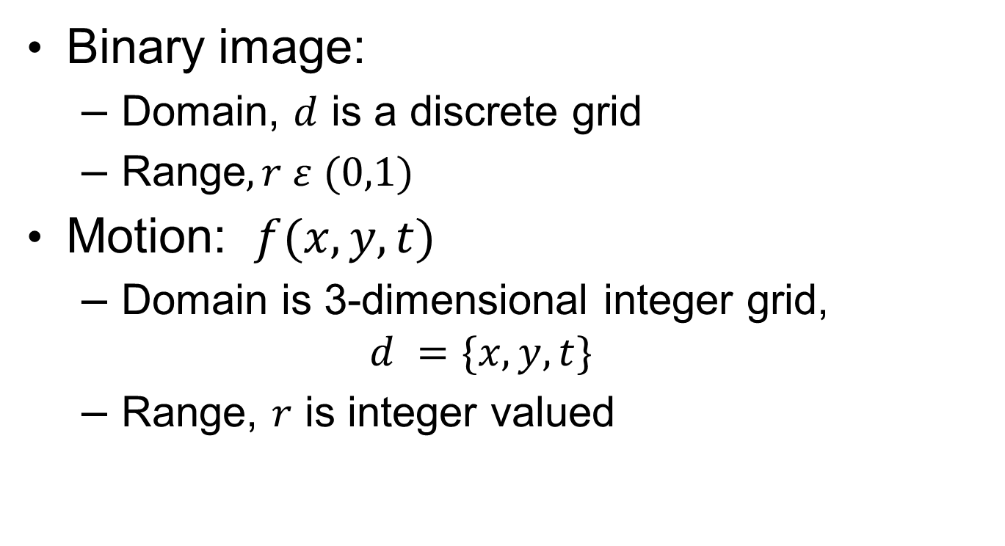
Binary image:
Domain, $d$ is a discrete grid
Range$, r ε (0,1)$
Motion: $f(x,y,t)$
Domain is 3-dimensional integer grid,
$$d =\{x,y,t\}$$
Range, $r$ is integer valued

Slide 10
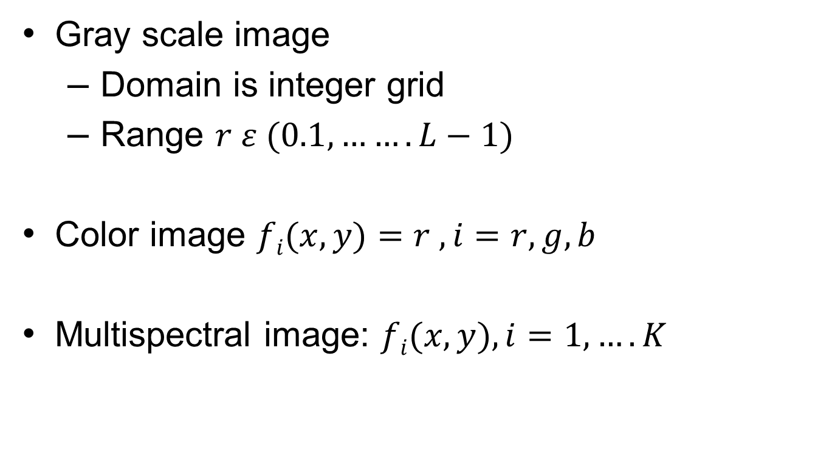
Gray Scale, Color, Multispectral Images
Gray scale image
Domain is integer grid
Range $r ε (0.1, …….L−1)$
Color image $fi(x,y)=r , i=r,g,b$
Multispectral image: $fi(x,y), i=1,….K$

Slide 11
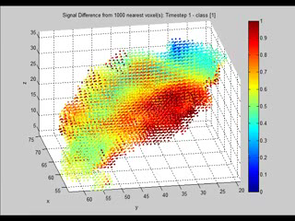
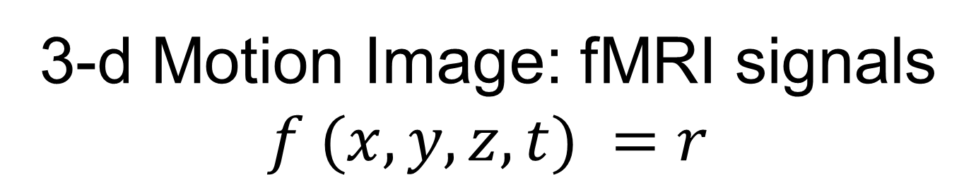
3-d Motion Image: fMRI signals $$f (x,y,z,t) =r$$

Slide 12
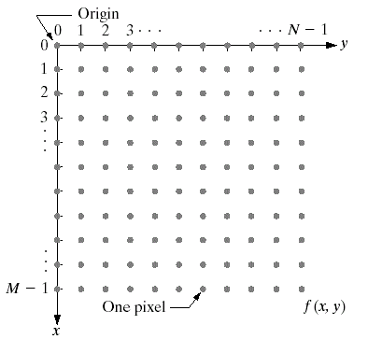
Image Representation by Arrays, Matrices and Vectors

Slide 13
Image Representation by Arrays
(Matrices and Vectors)

Slide 14
Color Images represented by three matrices

Slide 15
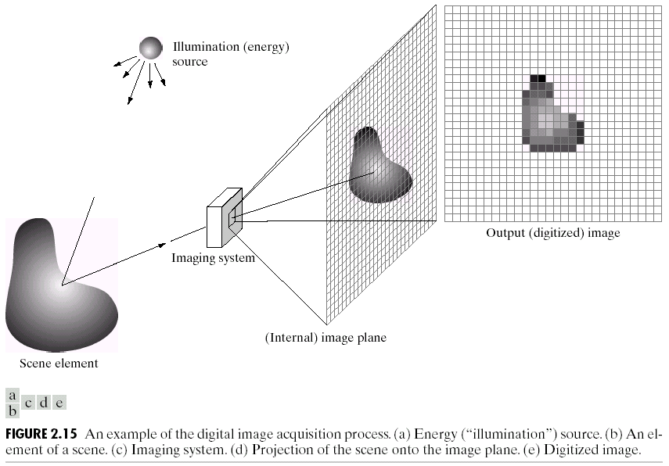
Sampling and Quantization

Slide 16
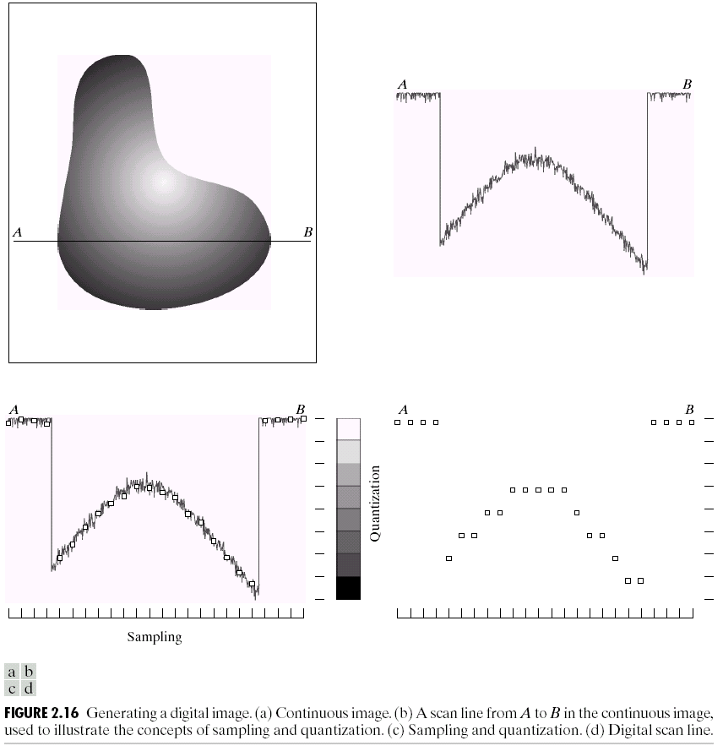
Quantization

Slide 17
Sampled and quantized image

Slide 18
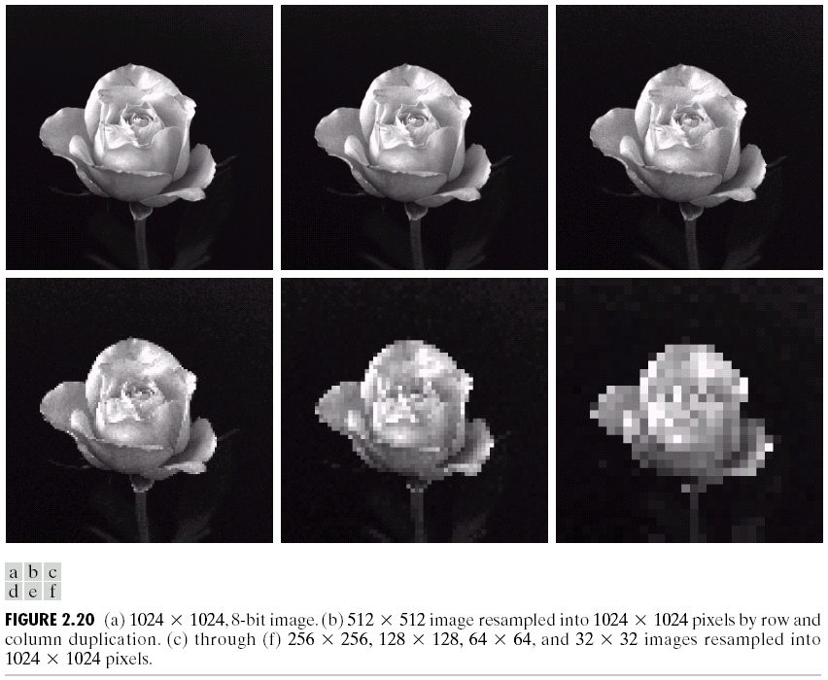
Down sampled Images

Slide 19
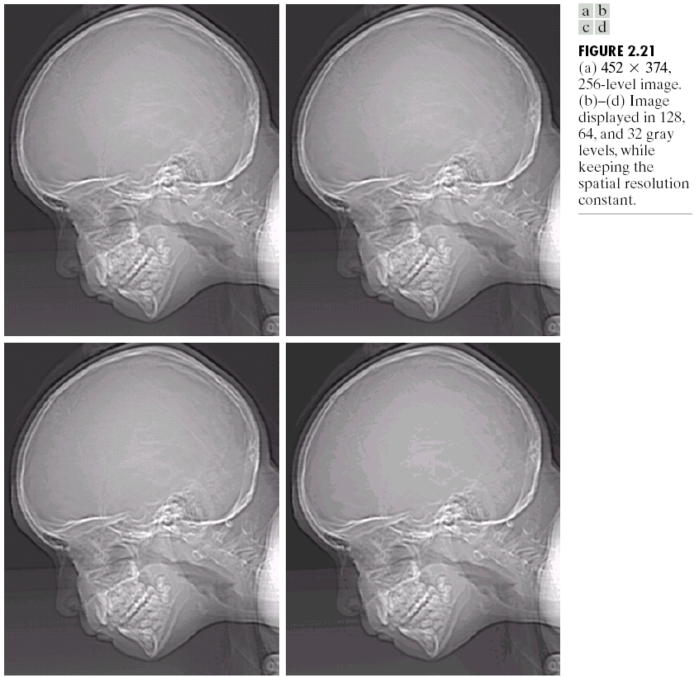
Quantization

Slide 20
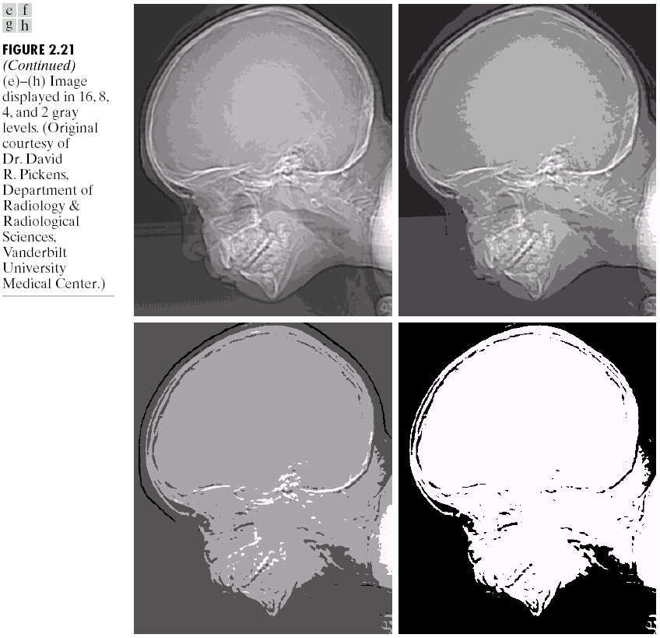
Quantized Images

Slide 21
Spatial and Gray Level Resolution
Spatial resolution is the smallest level of detail discernable in an image.
Number of line pairs per millimeter, say 100 line pairs per millimeter.
Gray-level resolution is the smallest discernable change in gray level. Very subjective.

Slide 22
Image Perception Model of Al Haytham.
2. Cognition:
Reunites the scene
1.Perception: Partitions the scene
sensör
Source
Nesne
Al-Haytham: Kitab-el Manazir
Optik Kitabı, 1021
Notes:
70-80 milyon Koni, 100-150 milyon çubuk ile nesneyi parçalıyoruz

Slide 23
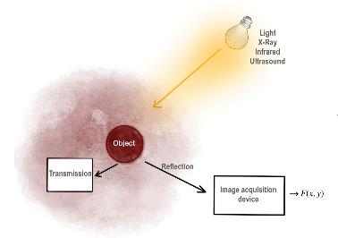
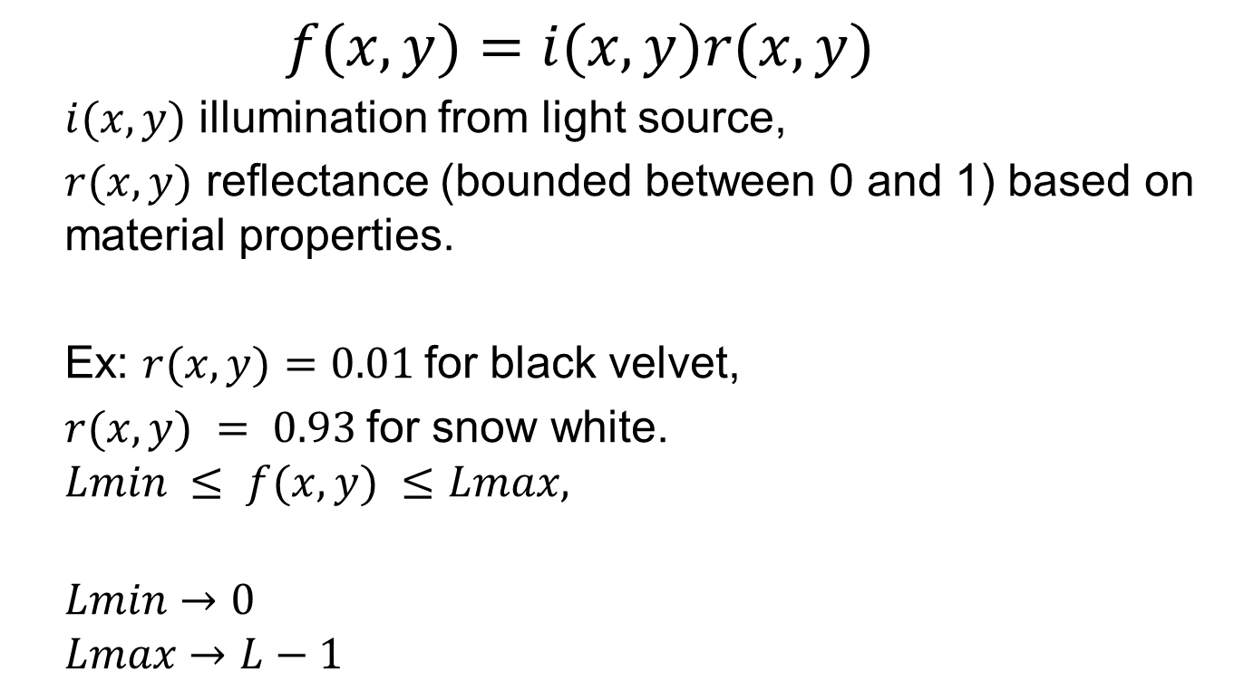
Simple Image Formation Model
$$f(x,y)=i(x,y)r(x,y)$$
$i(x,y)$ illumination from light source,
$r(x,y)$ reflectance (bounded between 0 and 1) based on material properties.
Ex: $r(x,y)=0.01$for black velvet,
$r(x,y) = 0.93$for snow white.
$$Lmin​ ≤ f(x,y) ≤Lmax​,$$
$$Lmin​→0$$
$$Lmax​→L−1​$$

Slide 24

Simple image formation model
Two-dimensional function
$$f(x,y): (x,y) r$$
$(x,y)$ : pixel position. integers and bounded
$r:$ brightness values, $[0, L−1]$

Slide 25
Interpolation
Q1: Given a discrete image, can we obtain its continuous version?
Q2: Given a low resolution image, can we increase resolution?
Interpolation
Inverse of sampling and quantization

Slide 26
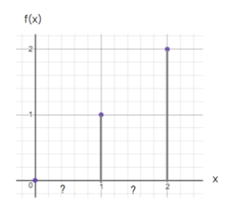

Interpolation
Image as a one dimensional function
$$f(x)=r$$

Slide 27
1. Nearest Neighbor interpolation
Rule: Assign the intensity value of the nearest pixel as the intensity value of a blank pixel.

Slide 28
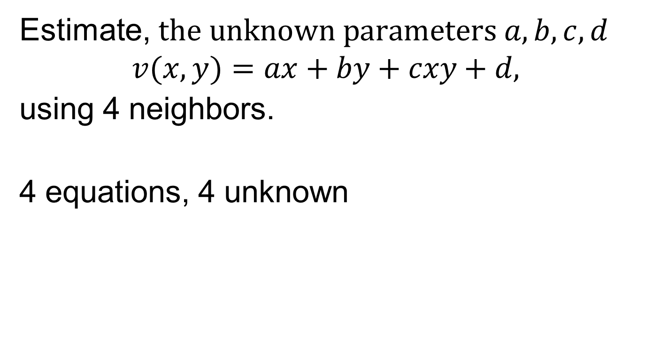
2. Bilinear Interpolation
Estimate, $the unknown parameters a, b, c, d$
$$v(x,y)=ax+by+cxy+d,$$
using 4 neighbors.
4 equations, 4 unknown

Slide 29
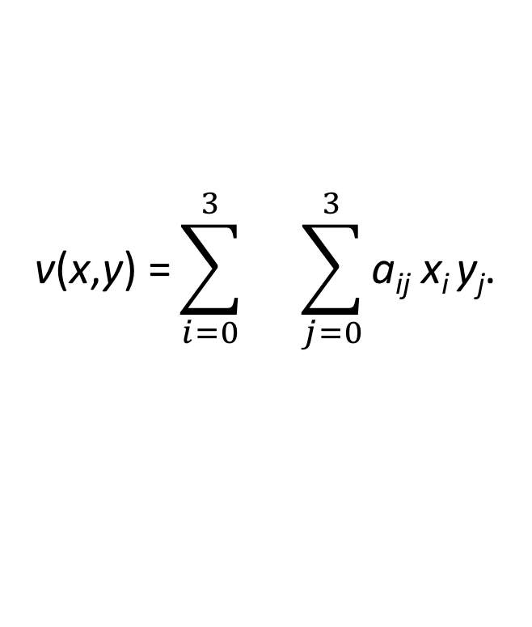
3. Bicubic Interpolation
16unknown, 16 equation
$$\text{v}\text{(}\text{x}\text{,}\text{y}\text{)} \text{=}\sum_{i=0}^{3}{}\sum_{j=0}^{3}{\text{a}\text{ij}\text{​} \text{x}\text{i} \text{y}\text{j}\text{.} }$$

Slide 30
Neighborhood and Distance
What are the neighbors of a pixels?
How to measure the distance between two pixels?

Slide 31

4-Neighborhood Systems
Given an image, $f(x,y)=r$
$$q N4(p) =$$
$$\{(x−1,y), (x, y−1), (x+1,y), (x, y+1)\}.$$

Slide 32
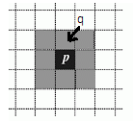

8-Neighborhood System
$$q∈N8(p) =\{\left(x−1,y\right), \left(x, y−1\right), \left(x+1,y\right), \left(x, +1\right),$$
$$\left(x−1,y−1\right),\left(x+1,y−1\right),\left(x−1,+1\right),$$
$$(x+1,y+1)\}.$$

Slide 33
Distance or Similarity Between Pixels
Spatial Distance
Color Distance

Slide 34

Spatial Distance
Continuous Domain: Euclidean Distance
$$DE (p1​,p2​) = [(x1​−x2​)2+(y1​−y2​) 2] 1/2,$$

Slide 35
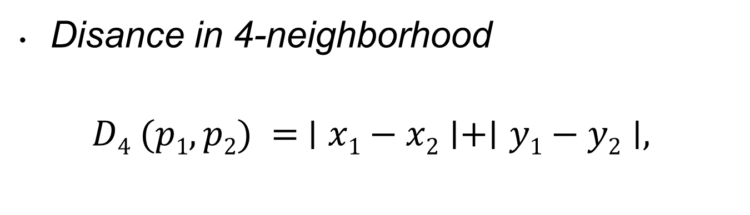
Discrete Grid: City Block Distance
Disance in 4-neighborhood
$D4​ (p1​,p2​) = ∣x1​−x2​∣+∣y1​−y2​∣,$

Slide 36
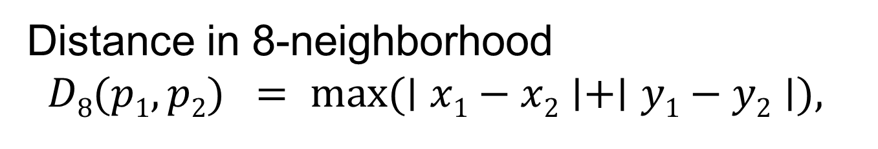
Discrete Grid: Chessboard distance
Distance in 8-neighborhood
$$D8​(p1​,p2​) = max⁡(∣x1​−x2​∣+∣y1​−y2​∣),$$

Slide 37
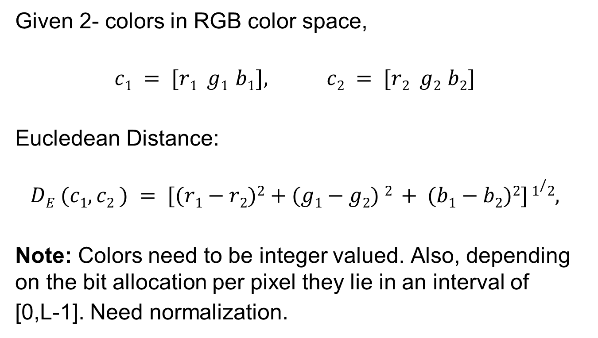
Distance between two colors
Given 2- colors in RGB color space,
$$c1 = [r1 g1 b1], c2 = [r2 g2 b2]$$
Eucledean Distance:
$$DE (c1, c2 ) = [(r1​−r2​)2+(g1​−g2​) 2 + (b1​−b2​)2] 1/2,$$
Note: Colors need to be integer valued. Also, depending on the bit allocation per pixel they lie in an interval of
[0,L-1]. Need normalization.

Slide 38

Example:
Find the City block distance and Checkerbord distances between the following pixels:
$p1 = (0,1) and p2 = (3, 3)$

Slide 39
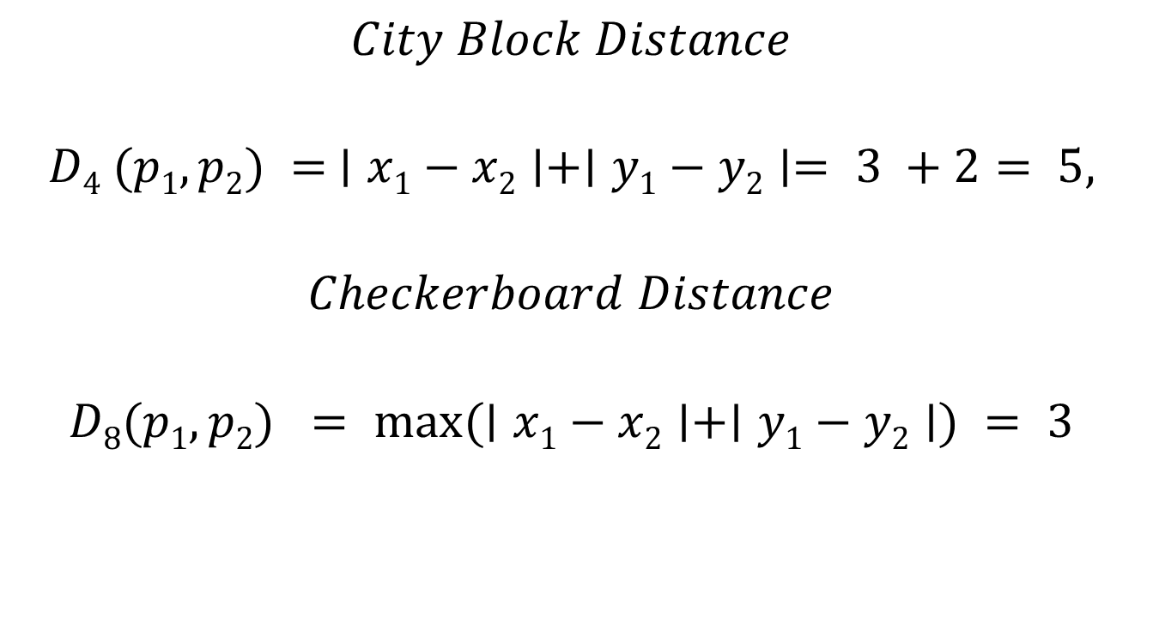
Answer:
$$City Block Distance$$
$$D4​ (p1​,p2​) = ∣x1​−x2​∣+∣y1​−y2​∣= 3 +2= 5,$$
$$Checkerboard Distance$$
$$D8​(p1​,p2​) = max⁡(∣x1​−x2​∣+∣y1​−y2​∣) = 3$$

Slide 40

Example:
Find the Eucledean distance between the following colors in RGB color space:
$$c1 = [0 1 1] and c2 = [3 3 3]$$

Slide 41
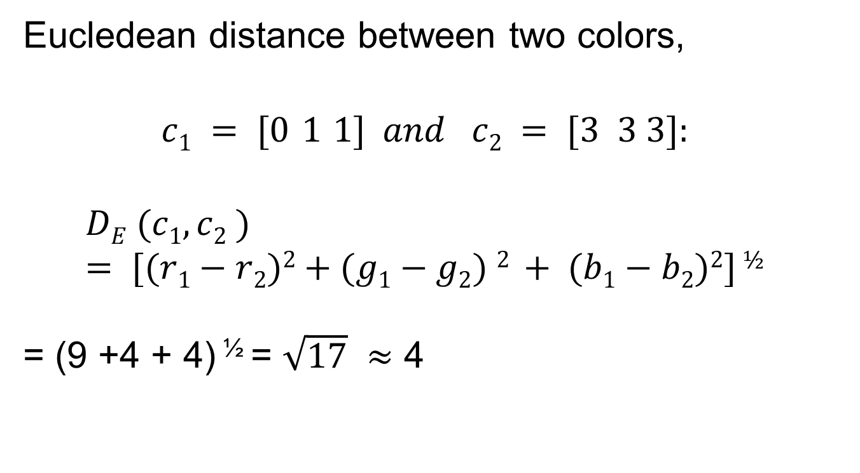
Answer:
Eucledean distance between two colors,
$$c1 = [0 1 1] and c2 = [3 3 3]:$$
$$DE (c1, c2 )= [(r1​−r2​)2+(g1​−g2​) 2 + (b1​−b2​)2] ½$$
= (9 +4 + 4) ^{½} = $\sqrt{17}$ $≈$ 4

Slide 42
Discrete geometry
Adjacency,
Path,
Connectivity,
Region,
Boundary,
Edge
on a discrete grid.

Slide 43

1. Adjacency
Let, $V= \{rk\}$ be a set of pixels defined over the intensity values used to define adjacency.
Ex: Given an 8 bits/pixel image, what is
$V=\{0, 1, 2\}$
$V=\{3\}$

Slide 44

4-Adjacency
Pixels, $p(V)$ and $q(V)$, defined over the intensity value set $V$, are 4-adjacent, if
$$p(V)∈N4​(q(V)).$$

Slide 45

8-Adjacency
Pixels, $p(V)$ and $q(V),$defined over the intensity values set $V$, are 8-adjacent, if
$$p(V) ∈ N8 ​(q(V)).$$

Slide 46
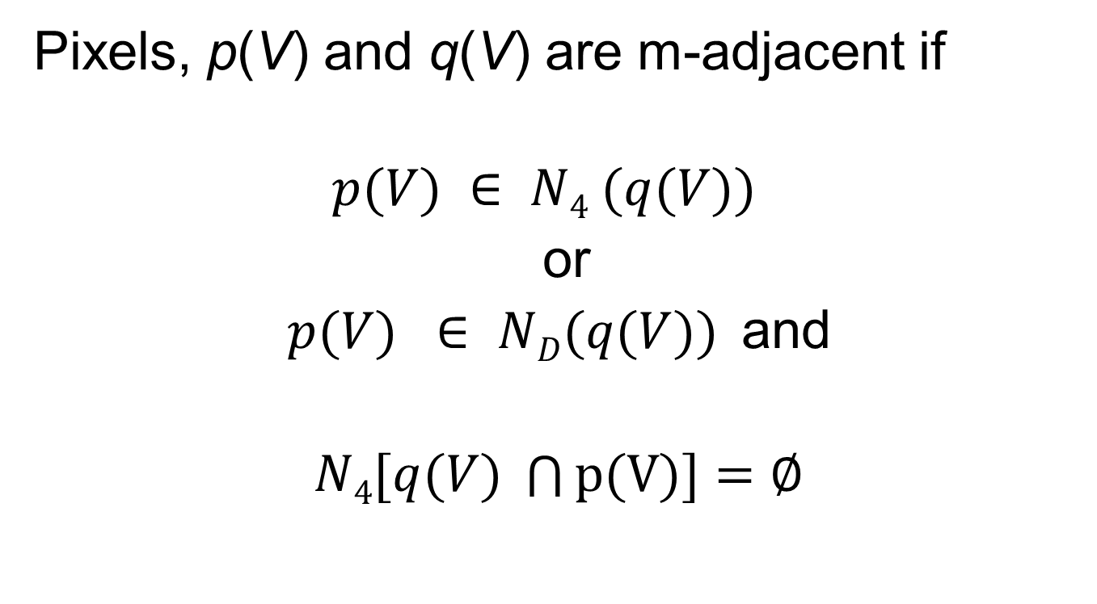
Mixed adjacency
Pixels, p(V) and q(V) are m-adjacent if
$$p(V) ∈ N4 (q(V))$$
or
$p(V) ∈ ND(q(V))$and
$N4[q(V) \bigcap{p(V)}]$ $=\text{∅}$

Slide 47
Example:
Find 4- adjacency, 8-adjacency and
m-adjacency of the center pixel for V={1}

Slide 48
Answer: V={1}

Slide 49
Adjacency
Two pixels p(V) and q(V) are adjacent if
q(V) ε N (p(V))
4-adjacency:
q(V) ε N₄ (p(V))
8-adjacency:
q(V) ε N₈ (p(V))
m-adjacency:
q(V) ε N_{m} (p(V))

Slide 50


Example:
Find the pixels that are 4-adjacent and 8-adjacen in $V=(0,1),$for the below image piece:
$$\begin{matrix}1 & 0 & 2 \\ 0 & 1 & 0 \\ 3 & 3 & 3\end{matrix}$$

Slide 51
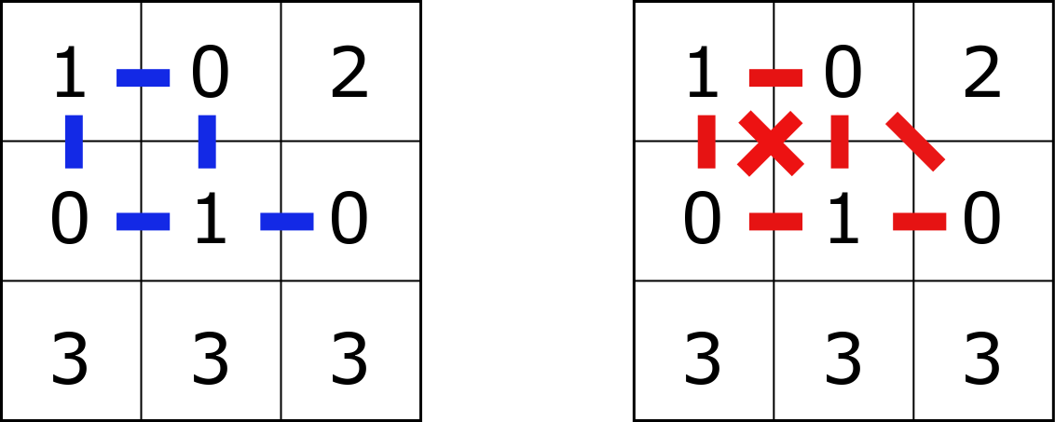
Answer:

Slide 52


Example:
Find the pixels that are 8-adjacent and m-adjacent, in $V=(0,1),$for the below image piece:
$$\begin{matrix}1 & 0 & 2 \\ 0 & 1 & 0 \\ 3 & 3 & 1\end{matrix}$$

Slide 53
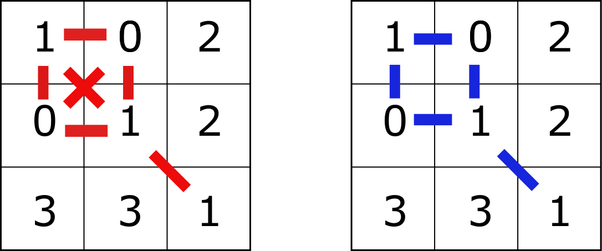
Answer:

Slide 54
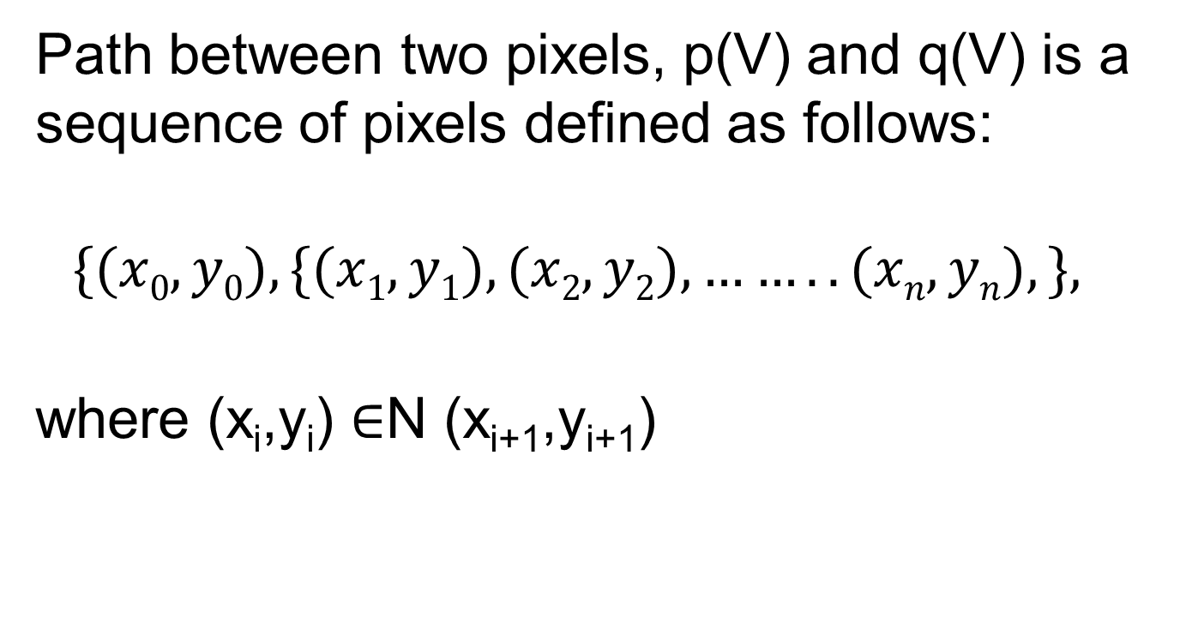
2. Path
Path between two pixels, p(V) and q(V) is a sequence of pixels defined as follows:
$$\{(x0,y0), \{(x1,y1), (x2,y2), ……..(xn,yn), \}​​,$$
where (x_{i},y_{i}) ∈N (x_{i+1},y_{i+1})

Slide 55
Closed Path
If the pixels at locations
(x₀,y₀) =(x_{n},y_{n}),
then the path is closed.
Note: Both the definition of path and closed path depends on the neighborhood system, defined for an image dataset.

Slide 56
3. Connectivity
Let S(V) be a set of pixels, with the brightness values defined over the set V, in an image, p(V) and q(V)are connected in S(V) if there exists a path between them consisting entirely of pixels in S(V).

Slide 57

Connected Component
Let $p(V)∈ S(V)$ be a pixel, the set of all pixels, $q(V)$, which are connected to $p(V)$ , is called the connected component.

Slide 58
Connected Set
If S has only one connected component, with respect to a set V, then it is a connected set with respect to V.

Slide 59
4. Region
Let R be a subset of pixels. R is called a region, if it is a connected set with respect to a predefined set V.
Fact: Objects can be described by regions.

Slide 60

Background
Given an image with $\{Ri\}$regions, corresponding to objects, the region complement $\{Ri\}c$is called background

Slide 61
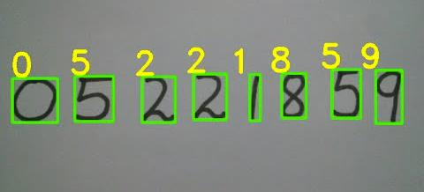

Hole
The region complement $\{Ri\}c$,
which is surrounded by the pixels in the region $\{Ri\}$ is called holes.

Slide 62

5. Boundary
Inner boundary of a region $R$ is a set of connected pixels $p∈R$, where $p∈ N ​(Rc).$
Outer boundary of a region $R$ is a set of connected pixels, $p∈Rc$, where $p∈N(R).$

Slide 63
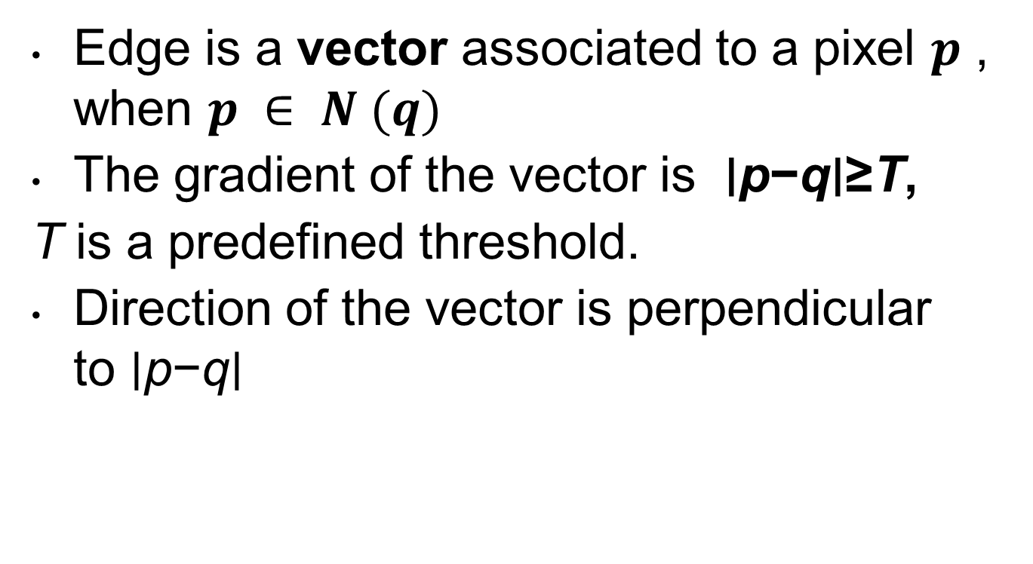
6. Edge
Edge is a vector associated to a pixel $p$ , when $p ∈ N (q)$
The gradient of the vector is ∣p−q∣≥T,
T is a predefined threshold.
Direction of the vector is perpendicular to ∣p−q∣

Slide 64

Mathematical Operations for DIP
Linear Operations
Nonlinear Operations
Array Operations
Matrix Operations
Probabilistic Operations
Set Operations
$$g(x,y) =H [f(x,y)].$$

Slide 65

Linear Operations
Operator, generates an output image
$$g(x,y) =H [f(x,y)].$$
Given two input images f₁(x,y) and f₂(x,y), H is a linear operator if superposition holds:
$$H[a1 f1(x,y) + a2 f2(x,y) ] = a1 H[f1(x,y)] + a2H[f1(x,y)]$$
Ex: 2- Dimensional Convolution

Slide 66
Nonlinear Operators
H is nonlinear if superposition property does not hold.
Ex: max, min, absolute value are nonlinear operations.

Slide 67

Array (Arithmetic) Operations
$$f1​(x,y)∓f2​(x,y)$$
$$f1​(x,y) . f2​(x,y)$$
$$f1​(x,y) / f2​(x,y)$$
Q: Where do we use the arithmetic operations?

Slide 68

Image Averaging
Consider a noisy image of a scene,
$$g(x,y)=f(x,y)​​+n(x,y)​​,$$
Zero mean noise: $E(n(x,y))=1/k∑​ni​(x,y)=0$
Suppose, we get several images
$$gi(x,y)= f(x,y)+ ni(x,y)$$
$$E(g(x,y)) = E(f(x,y)) + E(n(x,y)) =f(x,y)$$

Slide 69


Example: Image Averaging
Multiple images of the same scene
Noise removal by averaging

Slide 70

Image Difference for Change Detection $$g(x,y) =f1(x,y) − f2(x,y)$$

Slide 71
Matrix Operations
A.B=C

Slide 72
Note
Matrix and array operations are not the same
For multiplication
For division (inverse)

Slide 73

Example:
Find the array and matrix multiplications of the following 2 bits/pixel images:
$f1\left(x,y\right)= \begin{matrix}0 & 1 & 2 \\ 0 & 1 & 2 \\ 0 & 1 & 2\end{matrix} , f2\left(x,y\right)= \begin{matrix}0 & 0 & 0 \\ 1 & 1 & 1 \\ 2 & 2 & 2\end{matrix}$

Slide 74

Answer:
$gA\left(x,y\right)= \begin{matrix}0 & 0 & 0 \\ 0 & 1 & 2 \\ 0 & 1 & 4\end{matrix} , gM\left(x,y\right)= \begin{matrix}5 & 5 & 5 \\ 5 & 5 & 5 \\ 5 & 5 & 5\end{matrix}$

Slide 75

Normalization
Step 1: Shift:
$$gm​(x,y)=g(x,y)−min⁡(g(x,y))$$
Step 2: Scale:
$gs​(x,y)=round[(L−1)\frac{gm}{max⁡(gm​)}$ $​​]$

Slide 76


Example:
Normalize the outputs of the following images to 2 bits per pixel
$gA\left(x,y\right)= \begin{matrix}0 & 0 & 0 \\ 0 & 1 & 2 \\ 0 & 1 & 4\end{matrix} , gM\left(x,y\right)= \begin{matrix}5 & 5 & 5 \\ 5 & 5 & 5 \\ 5 & 5 & 5\end{matrix}$
Recall
$$gm​(x,y)=g(x,y)−min⁡(g(x,y))$$
$gs​(x,y)=round[(L−1)\frac{gm}{max⁡(gm​)}$ $​​]$

Slide 77

Answer:
$$gAN\left(x,y\right)= \begin{matrix}0 & 0 & 0 \\ 0 & 1 & 2 \\ 0 & 1 & 3\end{matrix}$$
$$gMN\left(x,y\right)= \begin{matrix}3 & 3 & 3 \\ 3 & 3 & 3 \\ 3 & 3 & 3\end{matrix}$$

Slide 78

Vectorize the Image Matrix
Given an (NxM) image matrix, concatenate all the rows (or columns)
$$f\left(x,y\right)= \left[\begin{matrix}f(0,0) & ⋯ & f(N−1,0) \\ ⋮ & ⋱ & ⋮ \\ f(0,M−1) & ⋯ & f(N−1,M−1)\end{matrix}\right]$$
Vector form:
$$f = [f(0,0),…..f(0,N−1), ……f(N−1, M−1)]$$

Slide 79
Vector multiplication
Y= Ax

Slide 80

Where do we use matrix and vector operations?
Suppose that g is a noisy vector image;
$g=Hf+n,$
$f$is the clean image,
$H$ is the multiplicative noise matrix
$n$ is the additive noise vector.
The clean image can be obtained from the noisy image by the following operation:
$f =H−1 (g− n)$

Slide 81
Probability Theory
What is
A probabilistic evet?
A deterministic event?

Slide 82

Probabilistic Operations
Given a discrete probabilistic event
$( zi, p(zi))$
Mean value
$μ=E(zi)=∑ zi p(zi),$
Variance,
$σ2=E(zi ​−μ)2=∑(zi ​−μ) 2 p(zi),$
kth central moment
$μk=E\left(\left(zi −μ\right)k\right)=∑\left(zi −μ\right)k p\left(zi ​\right).$

Slide 83

A popular density function for continuous random variable: Gaussian Function
$$p\left(z\right)=\frac{1}{\sqrt{2πσ^{2}}} exp⁡[−\frac{1}{2σ^{2}}{\left(z−μ\right)}^{2}​]$$

Slide 84

How do we define random events in Image processing?
Assume each color, $rk,$in the palette of image is a r.v.
Probability density function is approximated by normalized color histogram:
p(r_{k} ) $≈$ n_{k} / n
n_{k} = number of pixels with color , r_{k}
n= total number of pixels

Slide 85

Example: Mean color of an image
What is the mean color and its variance ?

Slide 86


Example: Assume that image generated by a random source, $fi(x,y)$
Define the brightness value of each pixel at location $(x,y)$ as a random variable, $zi(x,y)$ for all the images, $fi(x,y)$of the same scene,
$p(zi ​(x,y))≈ni​​(x,y)/n,$
$ni(x,y) :$number of brightness values with $zi​ (x,y),$for the pixel at location (x,y)
$n:$total number of images

Slide 87



Example: Define each pixel in the stack of images is a random variable, what is the mean color, and its variance?

Slide 88

Geometric Transforms: Affine Transforms
Affine transform is a linear mapping of a pixel at $x=(x1,x2)$to another coordinate $y = (y1, y2)$ as follows:
$$y = Ax + b$$
In matrix form
$\left[\begin{aligned}\text{y}\text{1} \\ \text{y}\text{2}\text{,} \\ 0\end{aligned}\right]=\left[\begin{matrix}A & b \\ 0 0 0… 0 & 1\end{matrix}\right]\left[\begin{aligned}\text{x}\text{1} \\ \text{x}\text{2}\text{,} \\ 1\end{aligned}\right]$= T $\left[\begin{aligned}\text{x}\text{1} \\ \text{x}\text{2}\text{,} \\ 1\end{aligned}\right]$

Slide 89

Geometric transforms: Affine Transforms
Keep parallel lines but not the angles and distances

Slide 90


Affine matrix T= $\left[\begin{matrix}A & b \\ 0 0 0… 0 & 1\end{matrix}\right]$
$\left[\begin{aligned}\text{y}\text{1} \\ \text{y}\text{2}\text{,} \\ 0\end{aligned}\right]$= T $\left[\begin{aligned}\text{x}\text{1} \\ \text{x}\text{2}\text{,} \\ 1\end{aligned}\right]$
T is 3x3 affine matrix for
Rotation
Scale
Reflection
Translation
Shear

Slide 92

Example: Rotation

Slide 93

Logical Operations
Suppose you are given a binary image, where the object pixels are represented by 1 and the background pixels are represented by 0. Represent this image by a point set.
$$f\left(x,y\right)= \begin{matrix}0 & 0 & 0 \\ 1 & 1 & 0 \\ 1 & 1 & 0\end{matrix}$$

Slide 94
Logical Operations
AND
OR
XOR
NOT

Slide 95
Logical Operations

